Slide 1
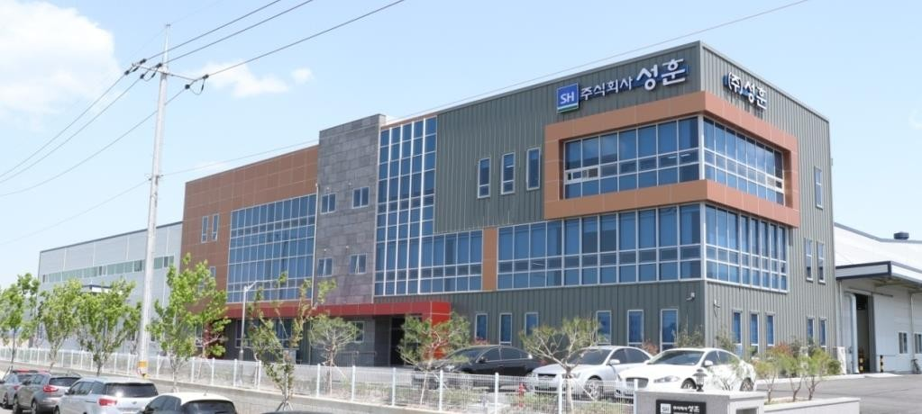

Slide 2
Contents
Management
Philosophy
Management Roadmap
Company Overview
History
Products Introduction
Manufacturing Process Overview
Annual Production Capacity
Sales Figure
Global Operation
Korea (HQ / Daegu)
Vietnam (Ho Chi Minh)

Slide 3
Management

Slide 4
Philosophy
Value Creation
“Beyond Customers’ Satisfaction”

Slide 5
Management Roadmap
Vision
Top Class Global Driveline Parts Manufacturer
Policy
Customer’s Happiness is Our Success
Goal (by 2021)
Quality : “0 ppm” customer quality
Cost : Lowest cost competitiveness
Revenue : 20M USD

Slide 6
Management Roadmap
Mission
Operation : Top class quality and productivity
System : Exceed IATF16949 requirements
Marketing : Long term partnership with Global Player
Strategy
HR : Interdependent key functional staff by experts
Management system : Quarterly review and upgrade
Value stream : Integration of Up-stream and Down-stream
Communication : Focus on Team Consensus build
Marketing : Pursuit for exclusive partnership with target customer
Global footprint : Customer centers and/or Representative offices
Sourcing : Quality focus

Slide 7
Company Overview

Slide 8
History
May. | 2022 | IATF16949 Certified(Vietnam)
Mar. | 2019 | Sunghoon-Vietnam Established
Mar. | 2018 | IATF16949 Certified
Jan. | 2018 | HQ Relocation to New Plant
Nov. | 2017 | Start of Production (CVJ Inner Races & Cages)
Sep. | 2007 | TS16949 Certified
Mar. | 2007 | Start of Production (Tripot Spider Assemblies)
Sep. | 2005 | Sunghoon-China Established (Dalian / Compressor Heads)
Jul. | 2003 | ISO9000 Certified
Jan. | 2001 | Start of Production (CVJ OR & TJ Housing Machining)
Oct. | 2000 | Technical License of Grinder Technology (Meccanodora / Italy)
Apr. | 1994 | Sunghoon Corp. Established (Manufacture of M&E, Automation)
Apr. | 1992 | Sunghoon International Established (Trading of Machineries)

Slide 9
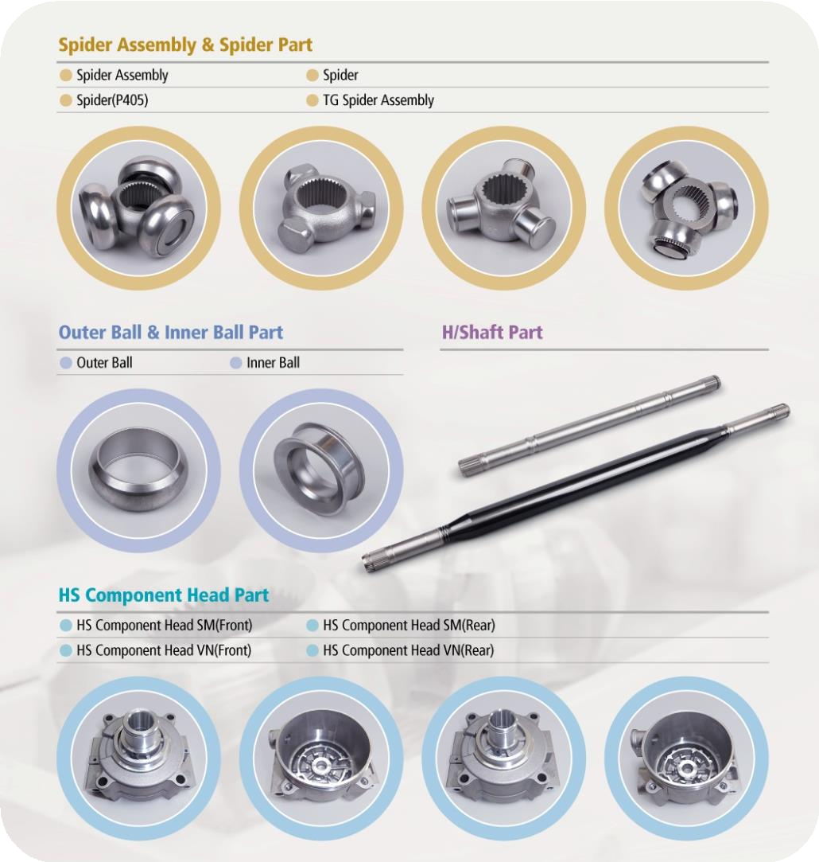
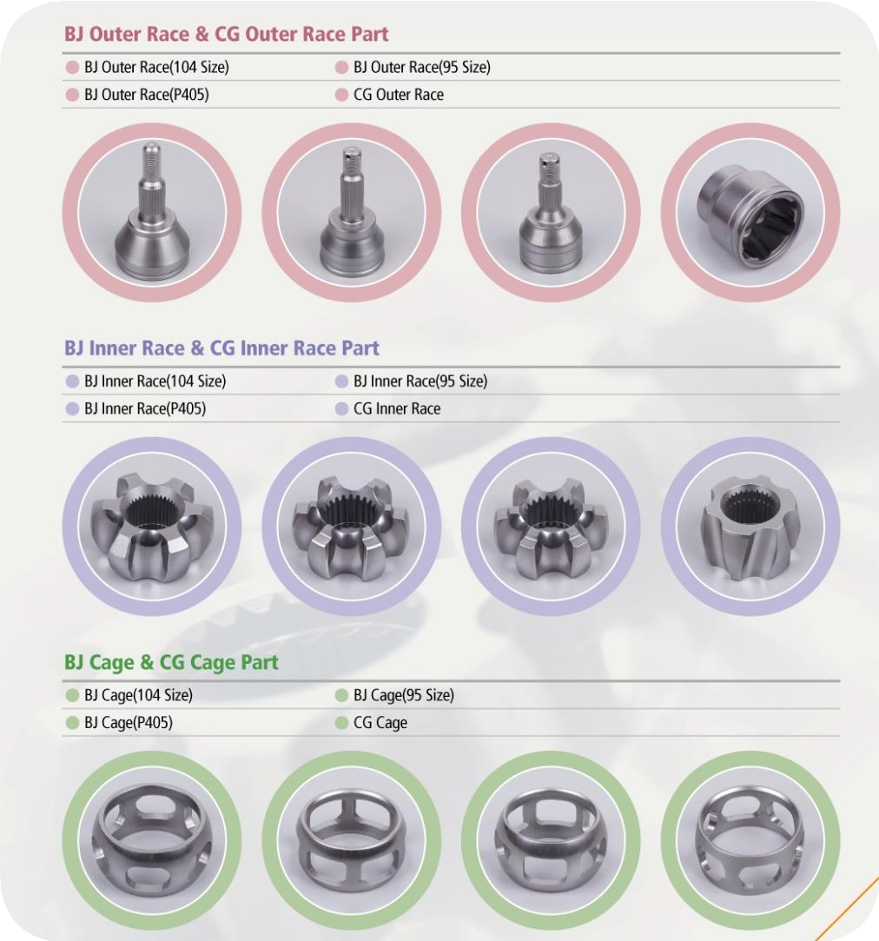
Overview of Products

Slide 10
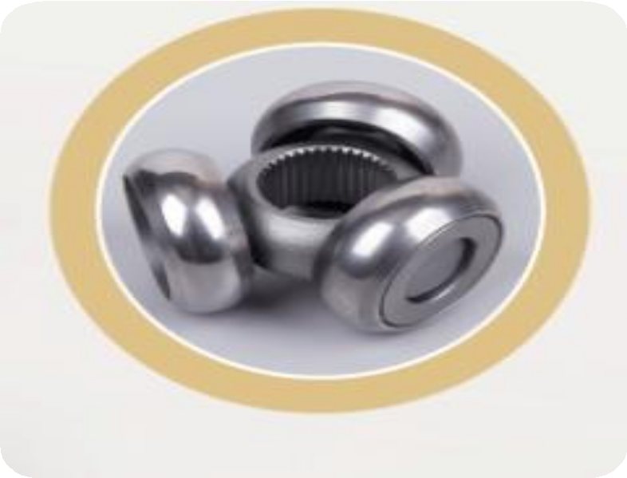
Products (Driveline)
Tripot Spider Assembly
Standard
Premium
Tri-Glide (Nexteer)
27size : GM (Cruz)
34size : GM (Lacross)
KPJ (erae-AMS)
19size : Kubota
26size : GM (Bolt), SYMC (Korando)
32size : FCA (C200)
34size : FCA (Pacifica)
37size : FCA (RAM)

Slide 11
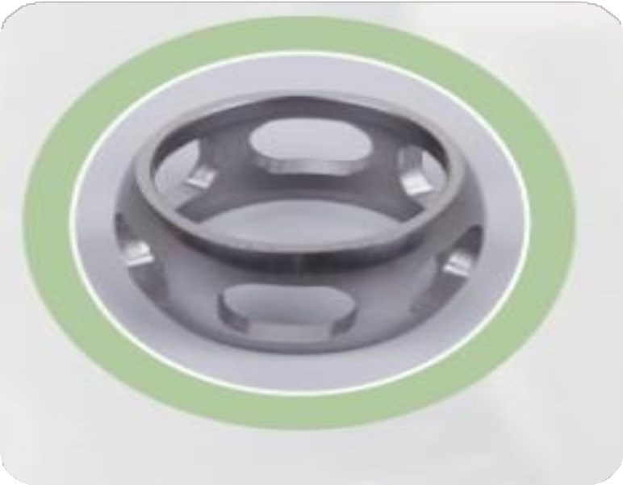
Products (Driveline)
Ball Joint Cages
Rzeppa
6-ball standard (erae-AMS)
34size : FCA (Pacifica)
37size : FCA (RAM)
6-ball HA (erae-AMS)
6-ball HE (erae-AMS)
CGJ
6-ball standard (Dae-Seung)
21size : HMC (Santa-Fe)
DOJ
6-ball standard (erae-AMS)
26size : FCA (C200)
40size : FCA (Pacifica)

Slide 12
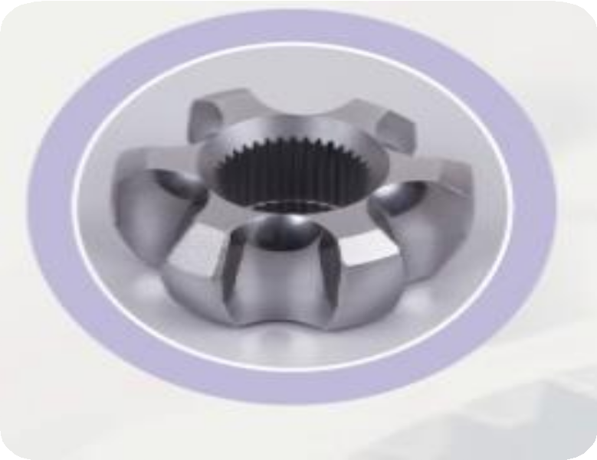
Products (Driveline)
Ball Joint Inner Races
Rzeppa
6-ball standard (erae-AMS)
34size : FCA (Pacifica)
37size : FCA (RAM)
6-ball HA (erae-AMS)
6-ball HE (erae-AMS)
CGJ
6-ball standard (Dae-Seung)
21size : HMC (Santa-Fe)
DOJ
6-ball standard (erae-AMS)
26size : FCA (C200)
40size : FCA (Pacifica)

Slide 13
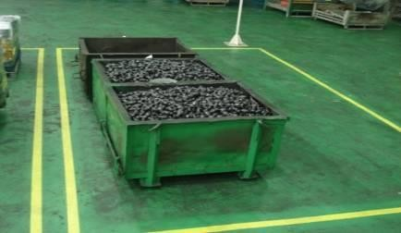
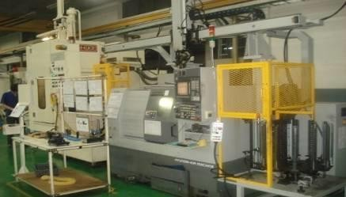
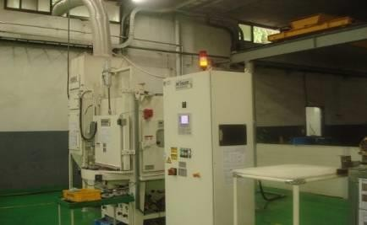
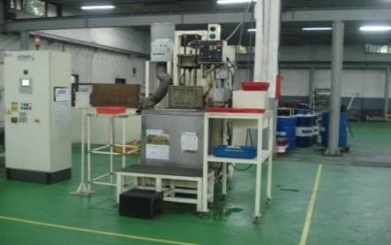
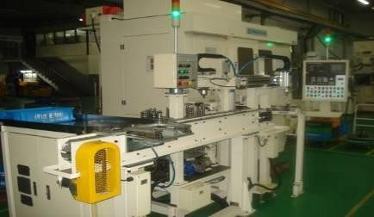
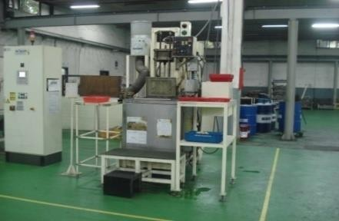
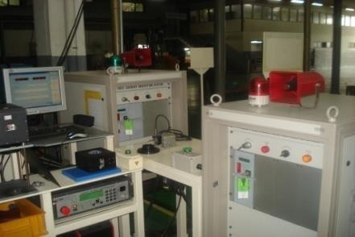
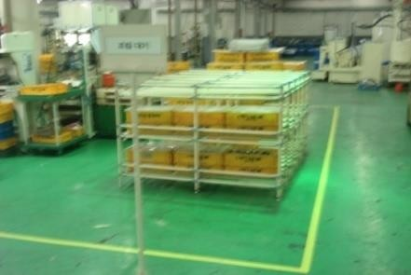
Manufacturing Process Overview
(Driveline)
Tripot Spider (Korea / HQ)
Heat Treater (Outsource)
Material Inflow(F.W)
＃10 Processing I.D and Face / ＃20 Broaching
＃30 Carburize, Quench & Temper
＃60 Blast/Surface Texture
＃50 Ultrasonic Washing
＃40 Trunnion Grinding
＃70 Ultrasonic Washing
＃80 Eddy Current ＆ Marking
Moving to stock Area

Slide 14
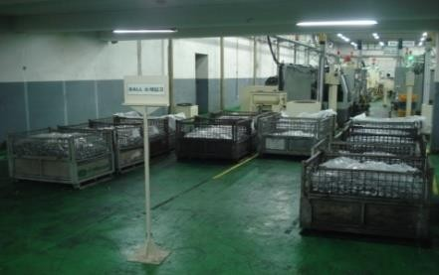
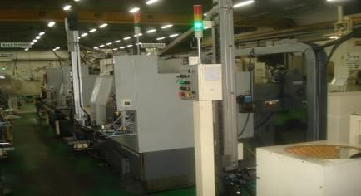
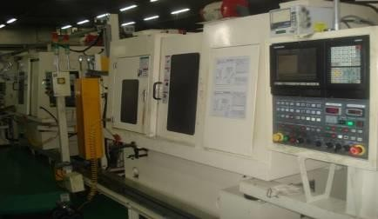
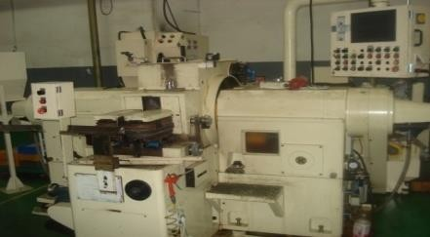
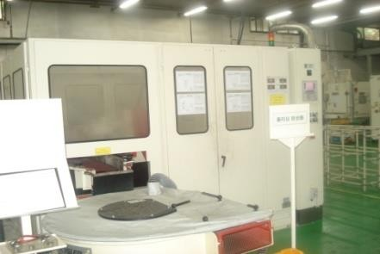
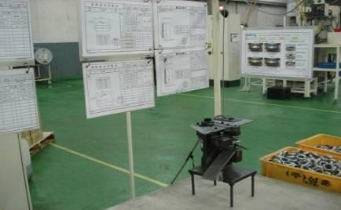
Manufacturing Process Overview
(Driveline)
Outer Roller (Korea / HQ)
＃10 Pro | cessing O.D and Face,＃20 Proces | sing
of I.D and Face
Heat Treater (Outsource)
＃30 Carburize, Quench & Temper
Material Inflow(F.W )
＃60 Washing
＃50 O.D Grinding , # I.D Grinding
＃40 Double Disc Grinding
＃80 Polishing
＃90 Class Marking
＃100 Eddy Current Test
Moving to Assembly line

Slide 15
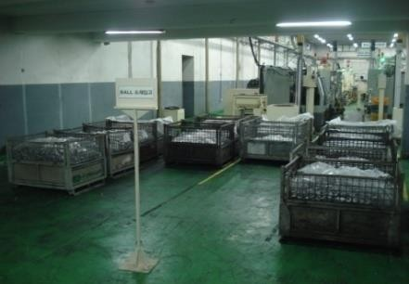
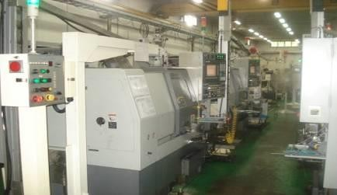
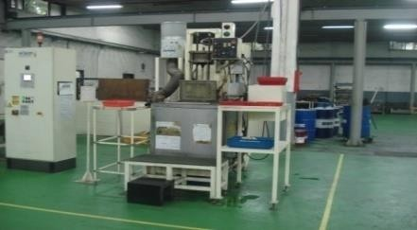
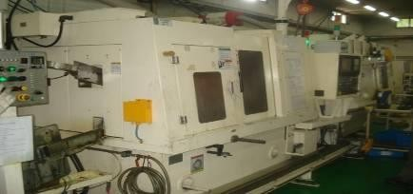
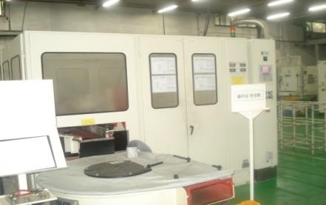
Manufacturing Process Overview
(Driveline)
Roller (Korea / HQ)
＃ | 10 Processing O.D and Face,＃20
Processing of I.D and Face
Heat Treater (Outsource)
＃30 Carburize, Quench & Temper
Material Inflow(F.W )
＃60 Ultrasonic Washing
＃50 O.D Grinding, ＃60 I.D Grinding
＃40 Double Disc Grinding
＃80 Polishing
＃90 Eddy Current Test
Moving to assembly line

Slide 16
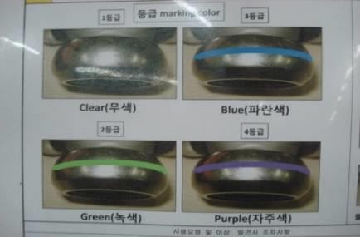
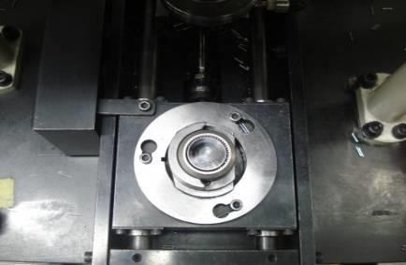
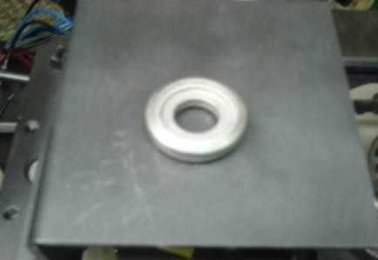
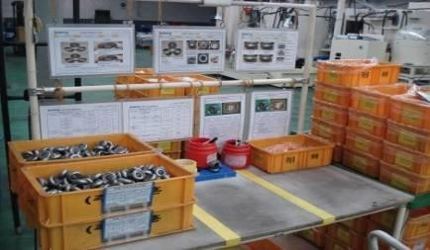
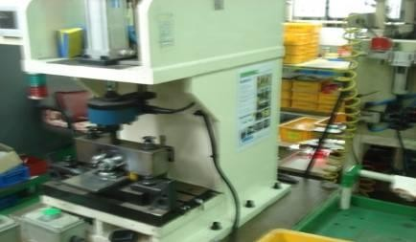
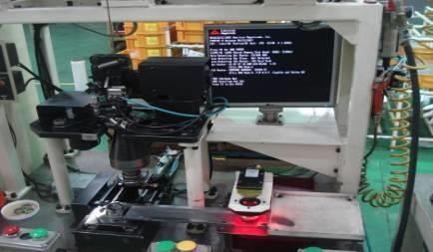
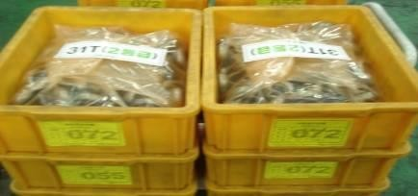
Manufacturing Process Overview
(Driveline)
Roller & Spider Assembly (Korea / HQ)
＃10 Identify Outer Roller
＃20 Dispense Needles to
Outer Roller
＃30 Match Inner Roller
Class
＃60 100% Visual Check
＃50 Press Fit 3-Roller Asm.
to Spider
＃40 Vision Check Number
of Needles
＃70 Packing

Slide 17
Manufacturing Process Overview
(Driveline)
Cage (Korea / HQ)
Tube
Cutting
Forming
Turning
OD/ID
Punching OR
Fine Blanking windows
Broaching OR
Soft milling windows
Carburizing
Grinding OD/ID
Grinding OR
Hard milling windows
Polishing

Slide 18
Manufacturing Process Overview
(Driveline)
Inner Race (Korea / HQ)
Broaching Internal Spline
Turning
OD/ID
Grinding
OD
Grinding
Tracks
Carburizing

Slide 19
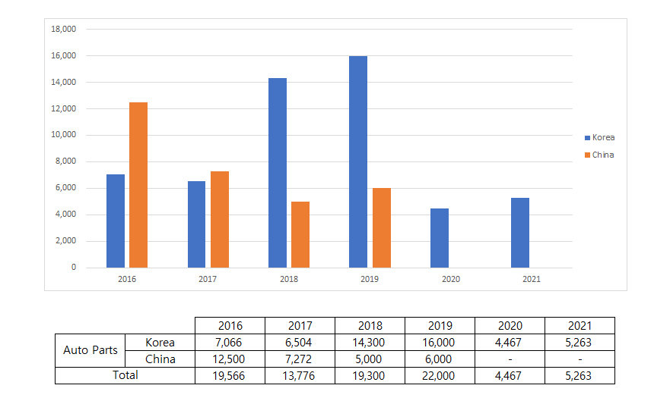
Sales Figure

Slide 20
Company Overview

Slide 21
History
Nov. | 2018 | ‘HAJIN VINA HIGH TECH “ Established (Land area to be used : 12,213㎡) Objectives of the project: Manufacturing of and process out and Inner races,cage,spider and in,out ball
Jan. | 2019 | 1st Investment Capital($800,000)
Sep. | 2019 | 2st Investment Capital($800,000)
Nov. | 2019 | Factory buiiding completed(Total Floor Erea: 7,437.24㎡)
Mar. | 2020 | 3st Investment Capital($800,000)
Apr. | 2021 | 4st Investment Capital($528,222.7)
Apr. | 2022 | 5st Investment Capital($1,000,000) (Total Investment Capital: $3,928,222.7)

Slide 22
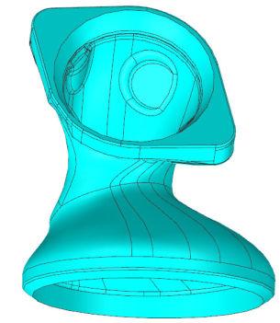
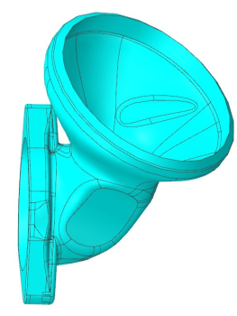
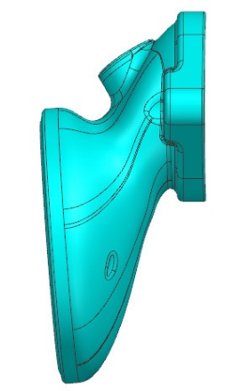
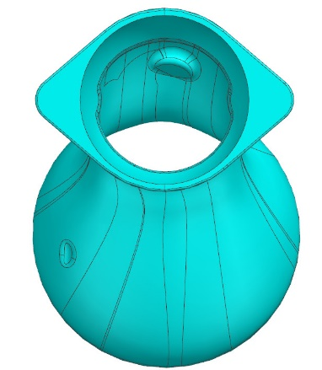
Overview of Products
Key Parts & Characteristics
(VIỆT NAM / VN)
Part | Outlook | Characteristic | Tolerance | Remarks
INLET-RH (11.54.936.729.027) |  | Inner Diameter | Φ130.60±0.2 | 1Kinds
 |  | Outer Diameter | Φ97.5±0.3 | †
 |  | Position | Φ0.5 | †
 |  | Roughness | Ra 3.2 | †
INLET-LH (11.54.936.729.028) |  | Inner Diameter | Φ130.60±0.2 | †
 |  | Outer Diameter | Φ97.5±0.3 | †
 |  | Position | Φ0.5 | †
 |  | Roughness | Ra 3.2 | †

Slide 23
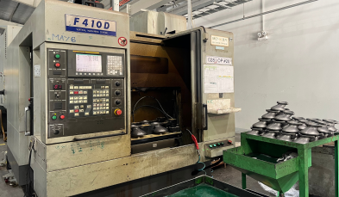
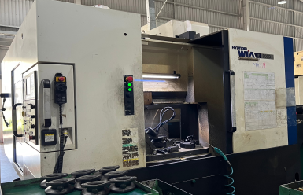
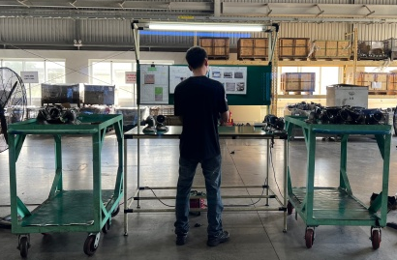
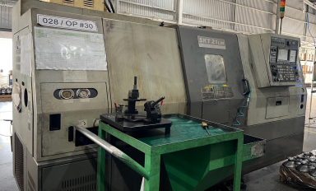
Manufacturing Process Overview
INLET-RH (11.54.936.729.027)
Material Inflow(F.W)
＃10 MCT M/C
＃20 MCT M/C
#50 Storage & Packaging
＃40 Leaktest, Rust oil
＃30 CNC M/C

Slide 24
Manufacturing Process Overview
INLET-LH (11.54.936.729.028)
Material Inflow(F.W)
＃10 MCT M/C
＃20 MCT M/C
#50 Storage & Packaging
＃40 Leaktest, Rust oil
＃30 CNC M/C

Slide 25
Manufacturing Process Overview
INLET-RH (11.54.936.729.027)
INLET-RL (11.54.936.729.028)
Material Inflow(F.W)
＃10 MCT M/C
＃20 MCT M/C
＃30 CNC M/C
＃40 Leaktest,
Rust oil
#50 Storage & Packaging

Slide 26
Sales Figure

Slide 27
Global Operation
Korea (HQ / Daegu) Vietnam (Ho Chi Minh)

Slide 28
Korea Operation
(HQ / Daegu)

Slide 29
Organization
(Korea / HQ)
CEO
Auto Parts
M/C & Tool
Administration
Build
Trading
CVJ Parts
Grinders
Special Purpose M/C
Grinders
MCT
V-Lathe
Affiliates
HAJIN : Trading & Auto Parts in Vietnam
SUNG-A Tech. : Domestic Sales

Slide 30
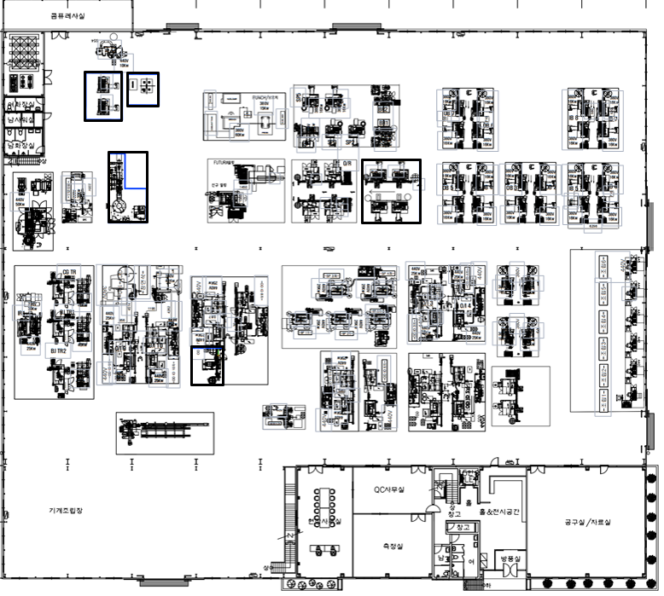
Plant Layout
(Korea / HQ)
.
Roller Turning
Material Stock
Material Stock
Spider Turning & Broach
Material Stock
O/R & I/R Soft Milling
Spider Asm.
After Grind for Ball
Spider & Ball Grinding
Cage & I/R Grinding

Slide 31
Manufacturing Facilities
(Korea / HQ)
Equipment | Maker | Country | Quantity | Remark
External Grinder | Sunghoon | Korea | 17 | Spider : 5, Inner Race : 1 Cage :5, Ball: 6
Internal Grinder | Sunghoon | Korea | 12 | Ball: 8 cage :4
Double disc Grinder | Shinhan | Korea | 1
Centerless Grinder | Hanhwa | Korea | 1
(6)Windows Grinder | Meccanodora | Italy | 2 | Cage
Assembly Machine | Sunghoon | Korea | 6 | Spider ASM
Washing M/C | ilsung | Korea | 2
Polishing M/C | Roesler | Germany | 1
Shot Blast M/C | Roesler | Germany | 1
Buffing M/C | Hyundai-wia | Korea | 4
Window Punching Press | Georg | Germany | 1 | Cage
Window Broaching M/C | Varinelli | Italy, Korea | 1 | Cage
IR Track Grinder | Sunghoon | Korea | 3 | Inner Race
Lathe | Hyundai-wia | Korea | 30
OR/IR Track Milling M/C | Sunghoon | Korea | 1
 | Meccanodora | Italy | 1
Broaching m/c | KMT | Korea | 1
Windows hard /soft mill | Sunghoon | Korea | 1 | Cage

Slide 32
Manufacturing Facilities
(Korea / HQ)
Equipment | Maker | Country | Quantity | Remark
Polishing(Barrel) M/C | Rosler | Germany | 1
Forming Press | Shandong ludi industry | China | 1 | Cage
Cutting M/C | Sunghoon | Korea | 1 | Cage

Slide 33
Quality Inspection Facilities
(Korea / HQ)
Equipment | Maker | Country of Manufacturer | Specifications | Year | Remark
Con-tracer | Tokyo-Seimitsu | Japan | 1700SD | 2007
Roundness Tester | Tokoyoseimitsu | Japan | Randcom 44SD | 2007
Roughness Tester | Tokoyoseimitsu | Japan | Surfcom 480A | 2007
Vickers Hardness Tester | Mitsutoyo | Japan | HM | 2007
Profile Projector | Mitsutoyo | Japan | 172-847D | 2012
CMM | Carl-Zeiss | Germany | Contura G2 776 AKTIV | 2013
Rockwell Hardness Testing M/C | KIM Tech | Korea | DTR-200N | 2013

Slide 34
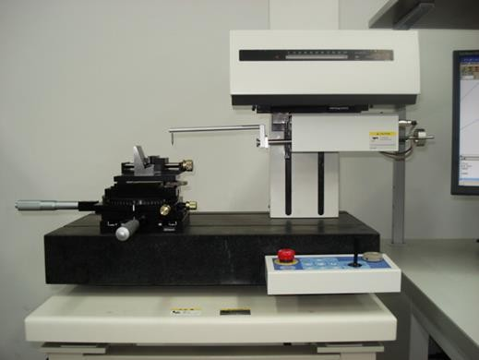
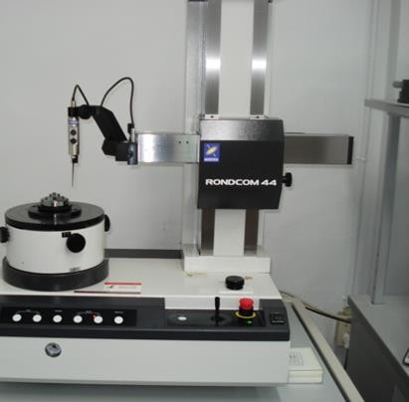
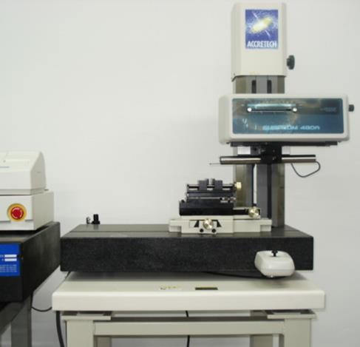
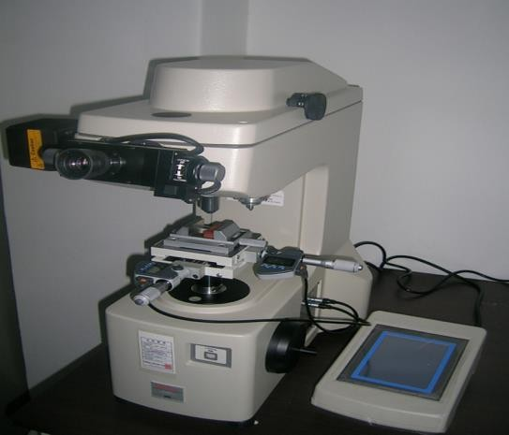
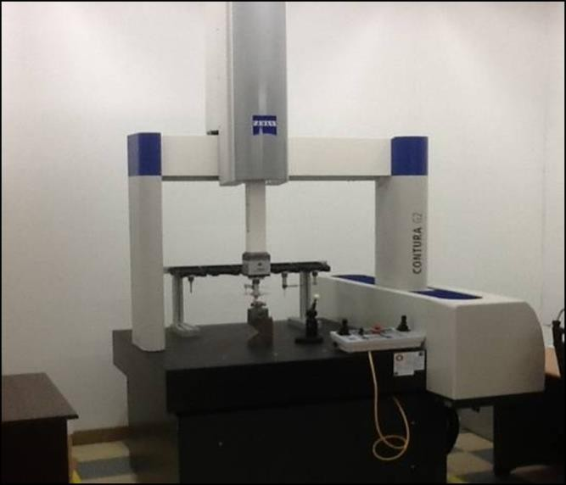
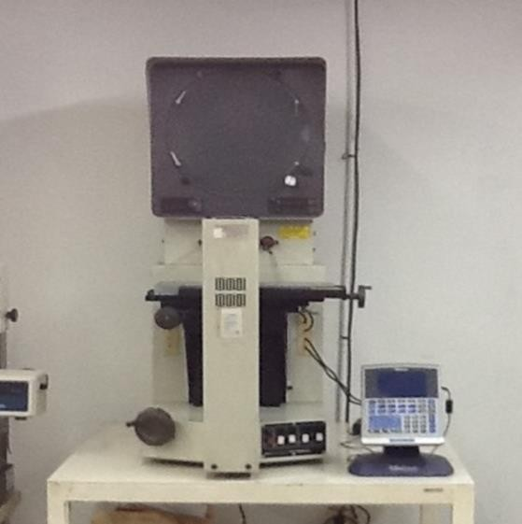
Quality Inspection Facilities
(Korea / HQ)
Con-tracer
Roundness
Tester
Roughness
Tester
Hardness Tester
Carl Zeiss CMM
Profile Projector

Slide 35
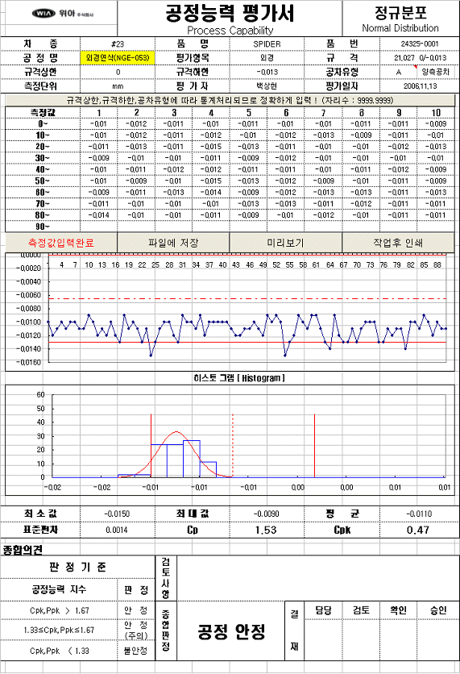
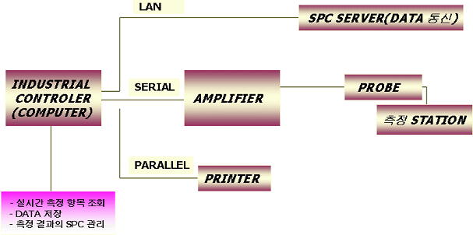
QMS
(Korea / HQ)
Real Time SPC Monitoring System

Slide 36
QMS
(Korea / HQ)
Key Parts & Characteristics
Part | Outlook | Characteristic | Tolerance | Remarks
Spider |  | Trunnion O.D | ±0.013 | 34T/31T 2Kinds
 |  | BCD | ±0.03 | †
 |  | Position | Φ0.1 | †
 |  | Position | Φ0.2 | †
Outer Roller |  | Outer Diameter | ±0.007 | †
 |  | Outer Dia. C/L | ±0.05 | †
 |  | Inner Diameter | ±0.007 | †
Inner Roller |  | Outer Diameter | ±0.007 | †
 |  | Inner Diameter | ±0.007 | †
 |  | Inner Dia. C/L | ±0.05 | †

Slide 37
Vietnam Operation
(Ho Chi Minh)

Slide 38
Organization
(VIỆT NAM / VN)

Slide 39
Plant Layout
(Vietnam)
대지 : 12,213㎡ 건평 : 8,890㎡
Potential

Slide 40
Manufacturing Facilities
(VIỆT NAM / VN)
Equipment | Maker | Country | Quantity | PART
CNC LATHE | WIA | Korea | 4 | CAGE
Cage internal Grinder | Sunghoon | Korea | 1 | CAGE
Cage external grinder M/C | Sunghoon | Korea | 1 | CAGE
Cage Window Milling | Sunghoon | Korea | 1 | CAGE
Cage Window Punch Press |  | Japan | 1 | CAGE
CNC LATHE | WIA | Korea | 6 | INNER RACE
Broach M/C | KM | Korea | 1 | INNER RACE
External grinder | Sunghoon | Korea | 1 | INNER RACE
Inner Race Track Grinding M/C | Sunghoon | Korea | 1 | INNER RACE
CNC LATHE | WIA | Korea | 1 | SPIDER
Trunnion grinding M/C | Sunghoon | Korea | 1 | SPIDER
CNC LATHE | WIA | Korea | 1 | FLANGE
CNC LATHE | WIA | Korea | 1 | FLANGE
Machining Center F500MV | WIA | Korea | 1 | FLANGE
Machining Center F500D | WIA | Korea | 4 | FLANGE

Slide 41
Manufacturing Facilities
(VIỆT NAM / VN)
Equipment | Maker | Country | Quantity | PART
Vertical Machining Center F410D | WIA | Korea | 3 | FLANGE
Machining Center NTT 70D | Komatec | Korea | 2 | FLANGE
Mazak MCT | Mazak | China | 5 | FLANGE
BCF | Dong Woo | KOREA | 2 | HEAT TREATMENT
Washing machine 01 Bottom Plate | Dong Woo | KOREA | 1 | HEAT TREATMENT
Temparing Furance | Dong Woo | KOREA | 1 | HEAT TREATMENT
Endothermic Gas Generator | Dong Woo | KOREA | 1 | HEAT TREATMENT
Shot Blast M/C | Ding Tai | China | 2 | HEAT TREATMENT
Nitriding Furnace | SOO IN |  | 2 | HEAT TREATMENT (MOULD)
Machining Center F660M | WIA | Korea | 2 | MOULD

Slide 42
Quality Inspection Facilities
(VIỆT NAM / VN)
Equipment | Maker | Country of Manufacturer | Specifications | Year | Remark
Coordinate Measuring M/C | Mitutoyo | Japan | BH-V507
Roundness Measuring M/C | Tokoyoseimitsu | Japan | Randcom 44SD
Contour Measuring M/C | Mitutoyo | Japan | CV-200
Sueface Measuring M/C | Tokoyoseimitsu | Japan | Surfcom-480A
Inverted metallurgical microscope | Nikon | Japan | MA-100N
Micro Vickers Hardness Teser | Mitutoyo | Japan | HAR-M-31
Polisher M/C | Hanalum Eng. | Korea | HAR-P-250
Profile Projector | Mitsutoyo | Japan | 172-847D
Cutting M/C |  | Korea
Rockwell Hardness Testing M/C | KIM Tech | Korea | DTR-200N
Mounting M/C | Hanalum Eng. | Korea

Slide 43
Quality Inspection Facilities
(VIỆT NAM / VN)
Con-tracer
Roundness
Tester
Roughness
Tester
Hardness Tester
Mitsutoyo CMM
Inverted metallurgical microscope

Slide 44
“Customer’s Happiness Is
Our Success”
Thank you for attention!

